Slide 1



Week 5, Lecture 9
Building a full-stack app - part 1

Slide 2
Admin stuff and reminders:
Don’t forget this week’s discussion topics!
https://login.codingdojo.com/d/309/123/1198
https://login.codingdojo.com/d/309/123/1199
Due Sunday night at 11:59 PM Pacific! Don’t fall behind!!
This week’s core assignments:
Users CRUD Modularized
Dojos and Ninjas (in CRUD section in Flask + MySQL module)
Get an early start! These assignments along with next week’s will consume a lot of time!
Get in touch with your Career Services Manager if you’ve opted in ASAP!!
Do your best! Hang on and keep the end goal in mind! You’re about to become a full-stack developer! Don’t quit!!
20-minute rule!
Reach out to TAs, instructors and your fellow students! Don’t wait!!
Don’t forget about Dojo Hall for collaboration and asking for help on Discord!

Slide 3
How are you with Flask?
1 = Not good
10 = Very good

Slide 4
How are you feeling today?
1 = Not good
10 = Very good

Slide 5
Week 5, Lecture 9 agenda:
Today’s lecture - focusing on the one part of the one-to-many relationship
Wednesday’s lecture: the many part of the one-to-many relationship, along with joining tables and data
Overview of our project we’ll build - including the wireframe
Project and debugging tips
The mysqlconnection.py file
The CRUD operations:
Create: Adding an item from your form to the database (CREATE)
Read:
Showing ALL the items from your database (SELECT) - initially without linking the other table (we’ll do that in Wednesday’s lecture)
Showing ONE item from your database (SELECT) - initially without linking the other table (we’ll do that in Wednesday’s lecture)
Update: Editing an item from your database through your form (UPDATE)
Placeholder vs. value attributes in your input tags
Delete: Deleting an item from your databases (DELETE)

Slide 6
Topics you should know:
Python basics
Loops - especially looping through a list of dictionaries (and classes)
f strings - will be useful in redirecting with path variables
OOP
Linking classes together
Class and static methods
Looping through a list of classes
If you’re rusty, please get yourself up to speed as soon as you can! Don’t forget about code reviews - I highly recommend them!! Same with talking to TAs and your fellow cohort classmates!

Slide 7
Topics you should know:
MySQL
Designing your tables
Forward engineering
CRUD queries (INSERT, SELECT, UPDATE, DELETE)
Joining tables - LEFT JOIN vs. (INNER) JOIN
Setting default values: NOW() for created_at and NOW() ON UPDATE NOW() for updated_at fields, and defaults for other columns as necessary
Set ON DELETE to CASCADE for your foreign keys
Flask
Routing - including path variables
Rendering HTML files - and passing values to them
Looping through lists, if statements and more in the HTML
Redirecting
(Soon: session for Week 6 when we do login and registration)
GET vs. POST requests
Modularization (hopefully you already watched the video!)

Slide 8
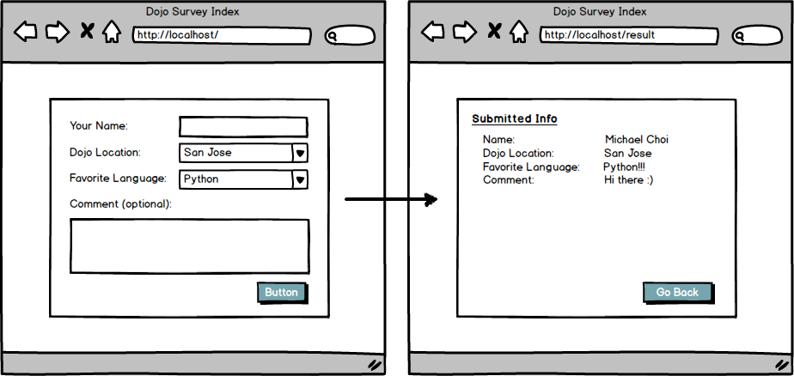
Wireframe (visual mockup):
Wireframes are visual mockups of the site/project that you will build. When you work for a company, you will often have to pitch a project to your managers and coworkers, so wireframes are useful to show what the product will look like. Below is a wireframe:
Here is a wireframe of the Dojo Survey assignment:

Slide 9
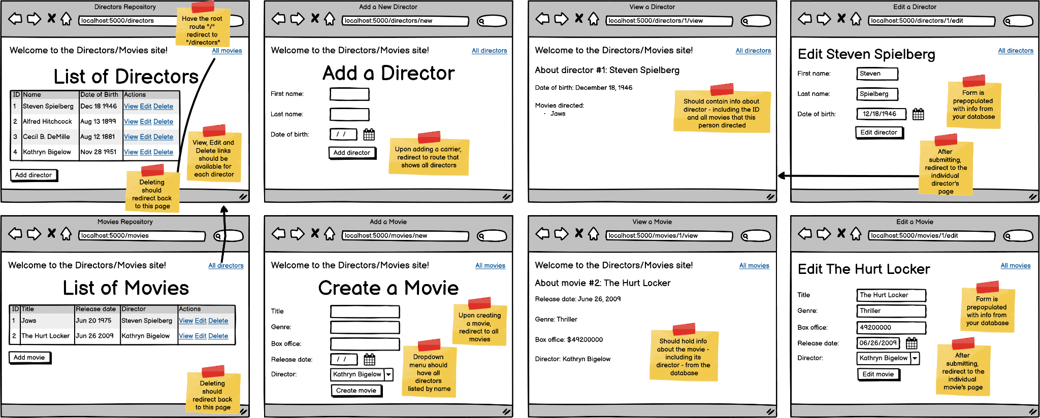
Our wireframe

Slide 10
Tips on creating your project:
Figure out what tables - and the columns you’ll need for them - your ERD will need. A good starting point is to look for forms where you’re adding/creating. But make sure to inspect the entire wireframe, as there may be additional columns you’ll need, especially if it needs a default value that won’t be specified in a form!
Identify the routes that your site requires - that includes GET and POST routes. Pay attention to the buttons and links in addition to the visual routes that you see in the wireframe. (We broke down the routes we’ll need for this project in the office hour earlier, so feel free to watch that on your own time.)
The number of HTML pages you’ll need should usually equal the number of pages in the wireframe itself. So in the previous wireframe, there are eight pages, so that’s why we will need eight HTML pages.

Slide 11
Tips on creating your project:
Dealing with relationships:
One-to-many: Focus on getting the one side to work first. For example, with cars and manufacturers, where it’s one-to-many with one manufacturer making many cars, start with the CRUD operations for the manufacturer first. Today’s lecture will focus on the one side first, with the next lecture dedicated to the many side along with joining tables.
Many-to-many: Do each side separately first, then focus on connecting them last.
Don’t panic! Take it one piece at a time - so one route or operation.
In terms of CRUD operations, I would do it in this order:
Create (CREATE)
Read (SELECT)
Read all first
Read one next
Update (UPDATE)
Delete (DELETE)

Slide 12
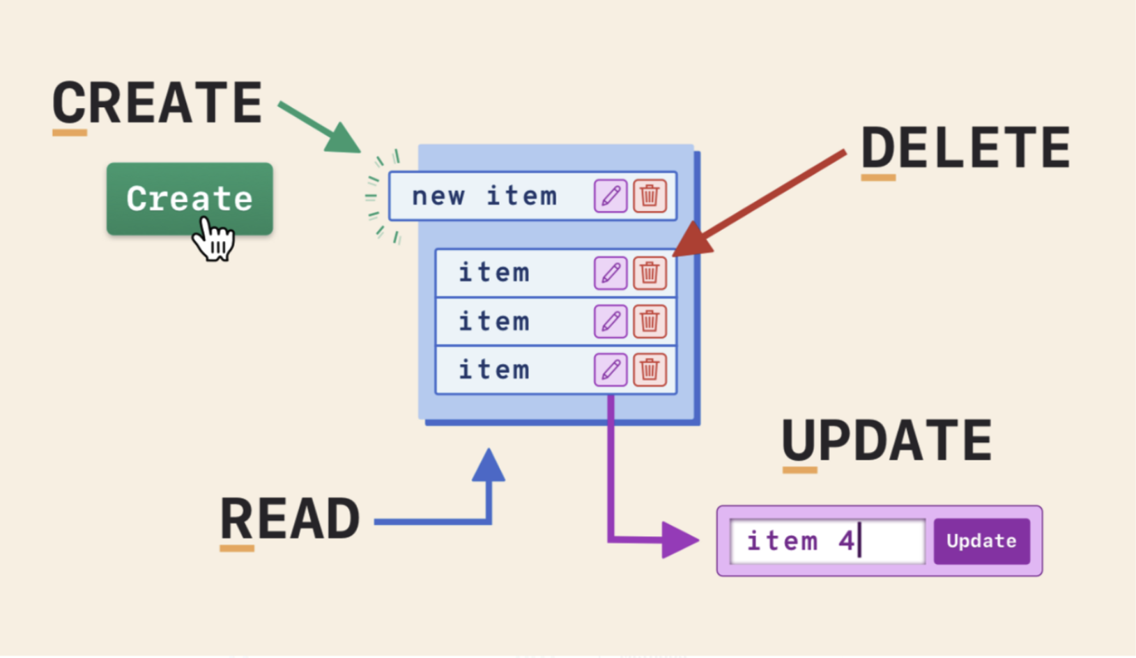
Visual on CRUD

Slide 13
Debugging tips
Use print statements! I highly recommend printing what you get back from the database to make sure you’re grabbing the right data.
Check your terminal’s output - you might see “Something went wrong”, which indicates an error in your SQL query.
Test your queries in MySQL Workbench!
Read the error message carefully in your browser - pay attention to the type of error, along with the line number(s) and file(s), and work backwards from that point to trace the issue!

Slide 14
Question 1
What output do you get when you run a(n):
INSERT query
SELECT query
UPDATE query
DELETE query

Slide 15
Question 1
What output do you get when you run a(n):
INSERT query - an ID (integer) corresponding to the most recent item created
SELECT query - a list of dictionaries
UPDATE query - None
DELETE query - None
This is from the mysqlconnection.py file!

Slide 16
Demo of the mysqlconnection.py file

Slide 17
The mysqlconnection.py file
To allow us to connect to MySQL, we will need a new package called PyMySQL installed in our environment: pipenv install PyMySQL
INSERT queries return the ID of the item just created - so for example, if a new Book was created whose ID is 8, you would get the value 8
SELECT queries return a LIST of dictionaries - here is an example of the output:
[{'id': 1, 'city': 'Seattle', 'name': 'Seahawks', 'stadium_name': 'Lumen Field', 'created_at': datetime.datetime(2021, 12, 15, 17, 20, 2), 'updated_at': datetime.datetime(2022, 1, 10, 18, 37, 10), 'players.id': 1, 'first_name': 'Russell', 'last_name': 'Wilson', 'number': 3, 'position': 'QB', 'players.created_at': datetime.datetime(2021, 12, 15, 17, 43, 44), 'players.updated_at': datetime.datetime(2022, 1, 12, 18, 6, 40), 'team_id': 1}, {'id': 1, 'city': 'Seattle', 'name': 'Seahawks', 'stadium_name': 'Lumen Field', 'created_at': datetime.datetime(2021, 12, 15, 17, 20, 2), 'updated_at': datetime.datetime(2022, 1, 10, 18, 37, 10), 'players.id': 2, 'first_name': 'Marshawn', 'last_name': 'Lynch', 'number': 10, 'position': 'RB', 'players.created_at': datetime.datetime(2021, 12, 15, 17, 43, 44), 'players.updated_at': datetime.datetime(2021, 12, 15, 17, 43, 44), 'team_id': 1}] # Each dictionary represents a row of data
UPDATE and DELETE queries return nothing
Queries with spelling/syntax errors return False - check the terminal and look for “something went wrong” to identify the problem (debug in MySQL Workbench!)

Slide 18
Tips while working on a project
Forms:
Include name="column_name" for any form inputs (including textareas and more), where column_name is the name of a column in your database
Don’t forget action="/route/to/send/data/to" and method="POST" in your form tag!
For editing, use value="{{ value_from_database }}" for most inputs. (Don’t use the placeholder attribute!)
ALWAYS redirect when handling POST requests! Also redirect when you’re deleting as well.
A route for showing the create/edit page is NOT the same as the route for performing the creating/editing in the database. Showing the page is a GET request, while creating/editing is a POST request. These will usually be two separate routes.

Slide 19
Tips while working on a project
You should create a new dictionary every time when you need to perform a query that requires data.
Don’t forget the ID of the item in your dictionary when editing or deleting! Same if you’re reading a specific item from the database.
For example:
data = {
# Additional values go here as needed, especially form data
"id": id, # Do NOT forget the ID where needed!
}
Use path variables when reading one item, editing an item or deleting an item! For example, “/books/view/<int:id>” for viewing an individual book’s page.
FUTURE: When adding validations, make sure you redirect to the correct route when validations fail - this usually is the route for adding or editing.
Most routes will be calling on your model, which will grab data from your database. So make sure you import your models in your controllers!!

Slide 20
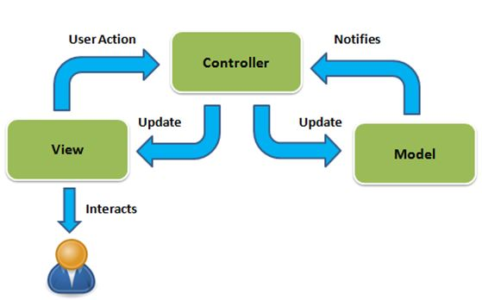
Your routes

Slide 21
Your routes
Your routes will usually call on your models; the models will handle the database stuff for you:
If you type from flask_app.models import model_file, then you call on the model by doing model_file.Model_Name.class_method_name(), for example book.Book.add_author(data)
If you type from flask_app.models.model_file import Model_Name, then you call on the model by doing Model_Name.class_method_name(), for example Book.add_author(data)
Each route will either return a view (render_template) or a redirect!

Slide 22
Your models
The models will interact directly with the database by importing the mysqlconnection.py file and calling on the connectToMySQL function!
Your models are where you will return data from the database through OOP
You will link models together as well! (More on that in Wednesday’s lecture.)

Slide 23
Let’s start building!

Slide 24
Bonus/group exercises

Slide 25
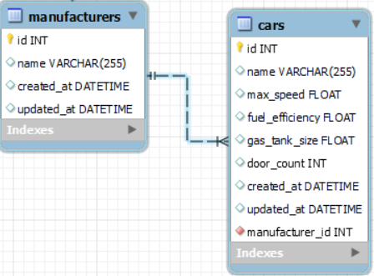
Review of queries:
Given this wireframe involving cars and manufacturers (different from our project - this is meant to be a review of queries):
Write a query that adds a new manufacturer named
“Ferrari” to the database.
Change the name of this manufacturer from “Ferrari”
to “Maserati”. (Assume its ID is 1, and use the ID.)
Grab the information about the Maserati without
linking any cars. (Assume its ID is 1, and use the ID.)
Grab ALL the manufacturers without their cars.
Remove Maserati from your database.
(Assume its ID is 1, and use the ID.)

Slide 26
Review of queries:
INSERT INTO manufacturers (name) VALUES ("Ferrari");
UPDATE manufacturers SET name = "Maserati" WHERE id = 1;
SELECT * FROM manufacturers WHERE id = 1; -- Use the id instead of the name
SELECT * FROM manufacturers;
DELETE FROM manufacturers WHERE id = 1; -- Always use id when deleting!

